Slide 1
VVPTA Officer Updates and S.T.E.A.M Lab Initiative
September 13, 2022

Slide 2
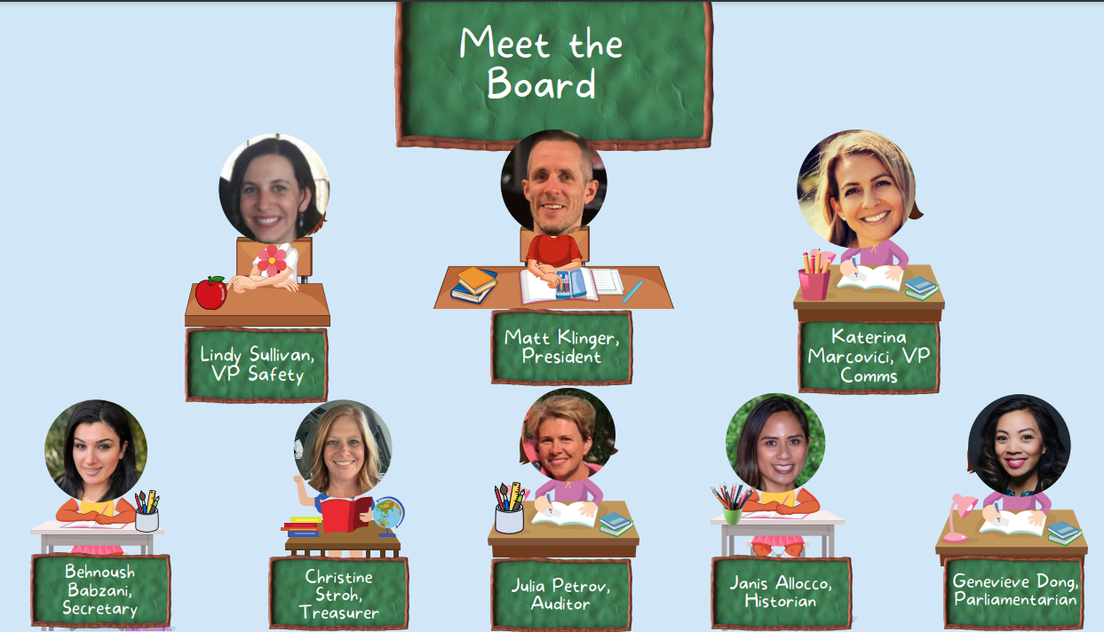

Slide 3
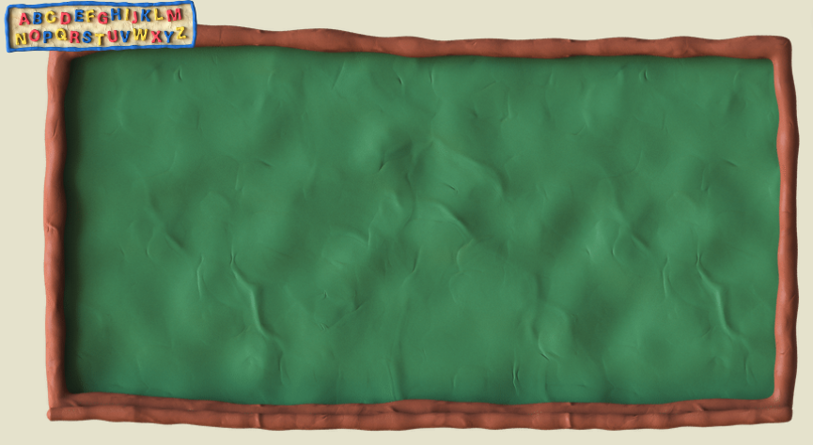
Building S.T.E.A.M.
A space where students engage in hands-on science, technology, engineering, art, and math (S.T.E.A.M.) activities each week.
Led by Michelle Foster and Frith O’Steen.
Michelle has led the school’s art docent program; Frith taught second grade at VVE for the past two years.
Activities in the Lab would be in addition to the students’ regular S.T.E.A.M.-related curriculum.
The Lab would consist of two dedicated classrooms and the outdoor spaces around VVE.

Slide 4
Partnering with LifeLab
Affiliated with the University of California Santa Cruz, LifeLab has been in operation for over forty years (https://lifelab.org/about/).
Promotes outdoor education and garden-based learning.
Currently operates at the following MDUSD elementary schools - Bancroft, El Monte, Fair Oaks, Gregory Gardens, Mt. Diablo, Pleasant Hill, Rio Vista, Sun Terrace, and Wren
VVPTA provides the funds to LifeLab, which is the contracting vehicle for S.T.E.A.M educators (~20 hours/week); at least 50% of their time must be spent outdoors.

Slide 5
Ensuring Sustainability
Focus on finding external funding support to reduce the additional future funding commitment needed from the VVE community.
Potential sources of future funding:
Matching funds from MDUSD.
Matching funds from Lifelab.
S.T.E.A.M. Lab Sponsor.
Reallocation of current VVPTA funding.

Slide 6
Lab Operations Can Begin Quickly
LifeLab, Frith, and Michelle have taken several steps to ensure the S.T.E.A.M. Lab is prepared to go operational upon the VVPTA’s approval of the initiative.
LifeLab is prepared to submit appropriate contracts to Michelle and Frith for their signature.
Frith and Michelle have been developing lesson plans and coordinating their efforts with each other and VVE teachers.
Because of this pre-planning, the S.T.E.A.M. Lab likely can begin operations within days.

Slide 7
Support Needed From the VVPTA
Approval at this meeting is needed for:
Establishing a S.T.E.A.M. Lab to be led by Michelle Foster and Frith O’Steen, who will be contractors of LifeLab.
Committing to pay Frith and Michelle, through Lifelab, a total of $20,000 through December 31, 2022 (i.e., $10,000 to each), plus an additional $2,000 to be paid to Lifelab for its 10% administrative fee.
Committing to plan and support a S.T.E.A.M. Lab-specific fundraising event in November or December 2022 to raise another $22,000+ to keep the Lab up and running for the rest of the school year (and ideally to put it on a good footing for next school year).
Volunteers in the Lab.

